Slide 1

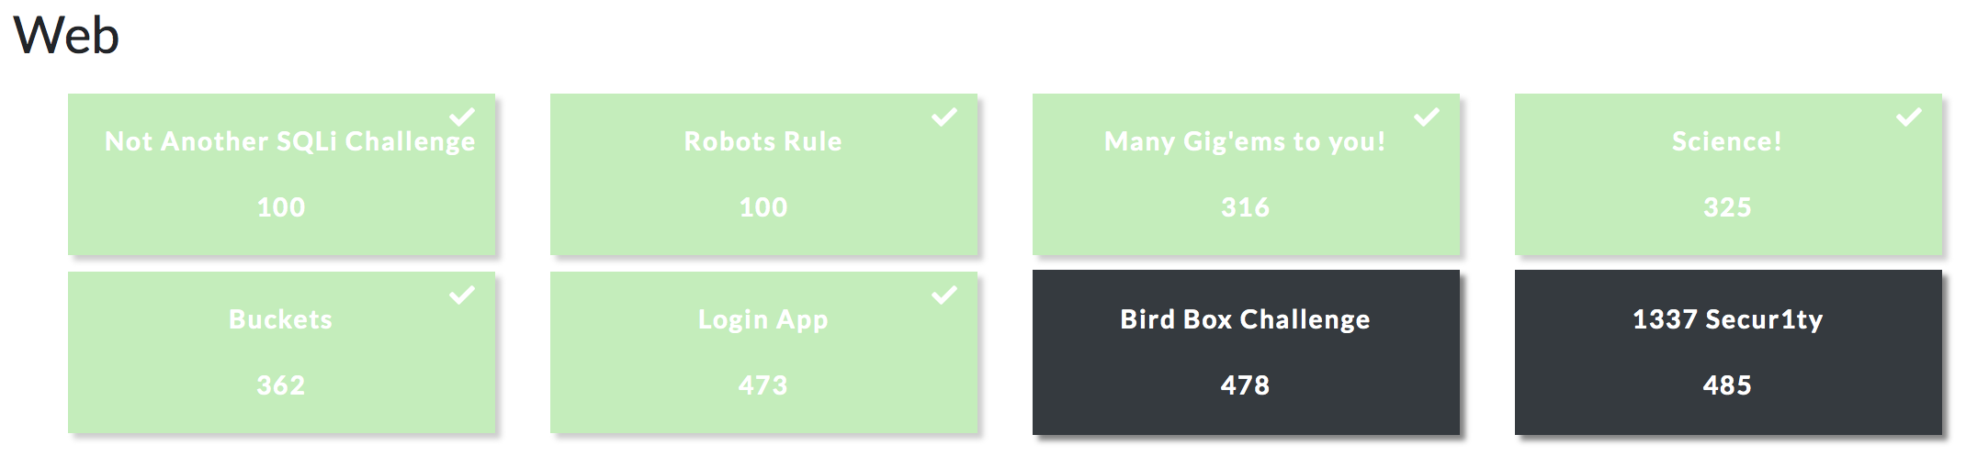
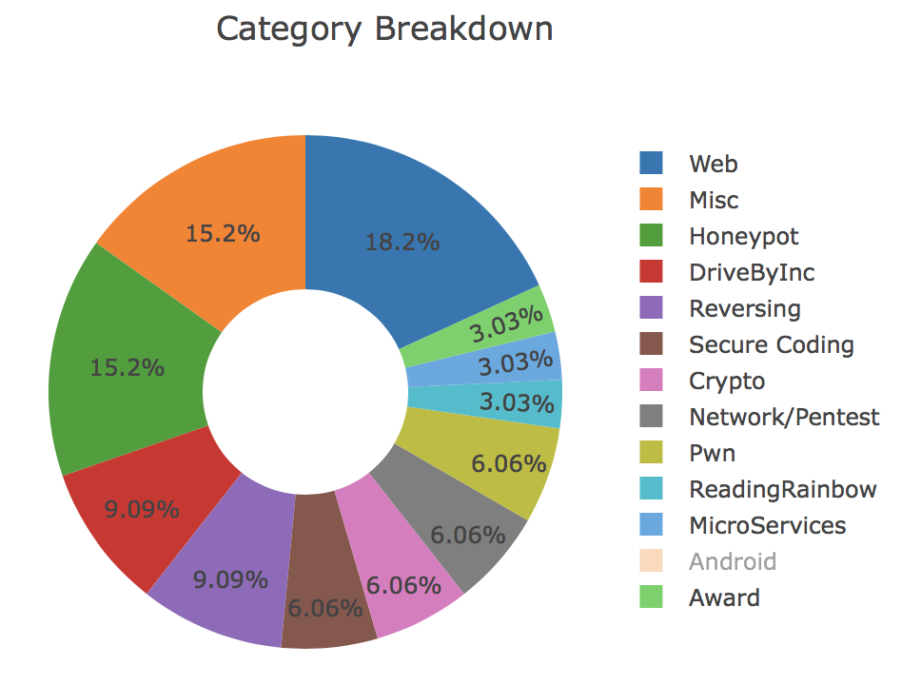

Slide 2

Hints, puns and available content is usually always the key solving CTF challenges
CTFs rarely have red herrings or things to explore that are not part of solving the challenge.
Notes:
Examples;
If you haven’t cracked it with RockYou, then it’s probably not meant to be bruteforced
If you can’t crack a hash with hashkiller, it’s probably shouldn’t or doesn’t need to be cracked

Slide 3
Some challenges that essentially told you which path to take
Not Another SQLi Challenge It was a trivial SQL injection task
Robots Rule Read robots.txt to progress
Buckets Amazon web buckets
Stop and Listen Listen to incoming traffic
Always look for the obvious signs,
or read the information given to you
Notes:
User-agent to Google’s web crawler

Slide 4
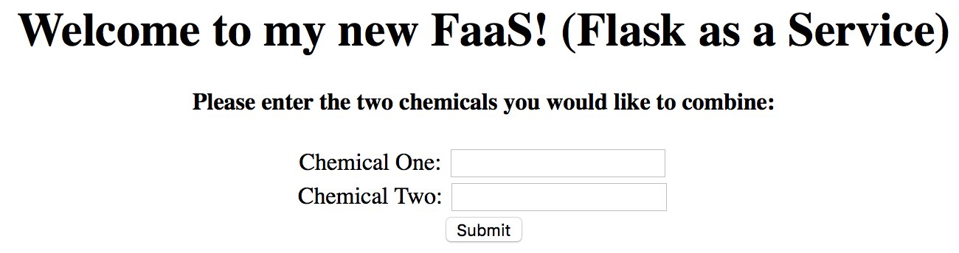
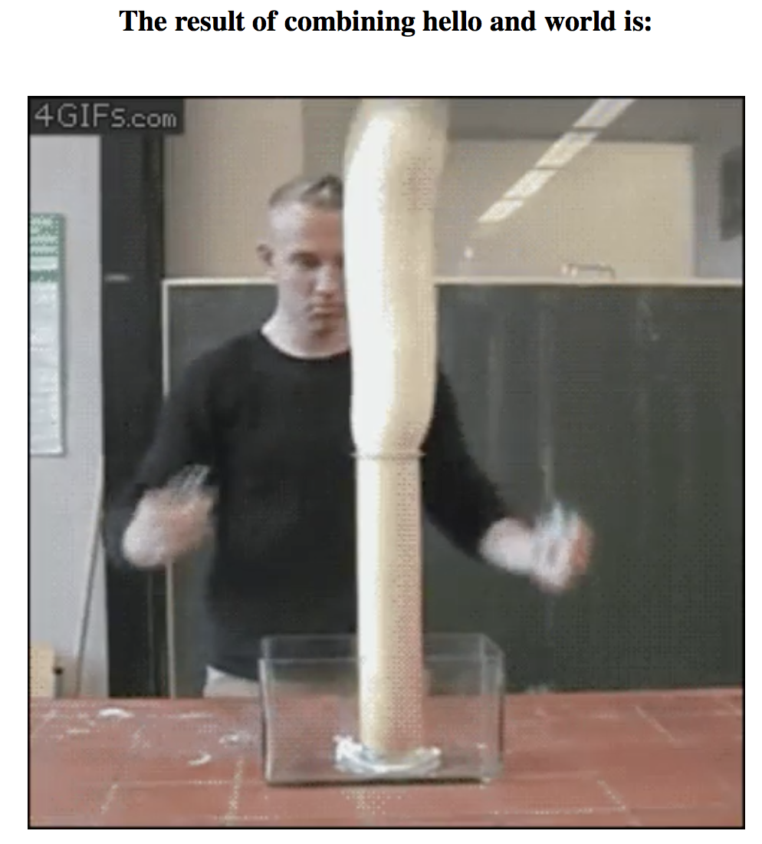

Science!
After poking around for a bit, it was clear you needed the right ”chemical one” and/or “chemical two” input to progress.
Notes:
Read the page source
Look at JS and other includes
Test all the inputs and functionality
Click every link
Inspect the traffic with burp
If you are stuck, check for ”old but gold” vulnerabilities like very tampering, directory traversal
But usually by this point you will have a “clue” or idea on how to proceed

Slide 5
Before we go a further, a bit of information on Flask
Flask relies on the Jinga template engine and Werkzeug WSGI toolkit.
https://www.palletsprojects.com/p/jinja/
https://www.palletsprojects.com/p/werkzeug/
https://wsgi.readthedocs.io/en/latest/
Flask is a framework (i.e. a code library) that uses python. Similar to Tornado, Pyramid and Django. Better intro to Flask here.
Picture from http://webapp-dev.blogspot.com/2012/07/flask-guide-for-web-application.html
Notes:
WSGI - Web server gateway interface - it describes how web servers interact with web applications.

Slide 6
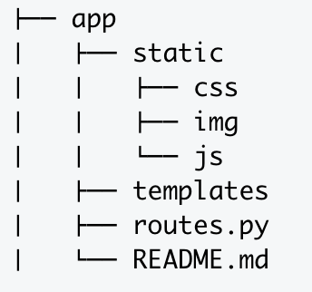
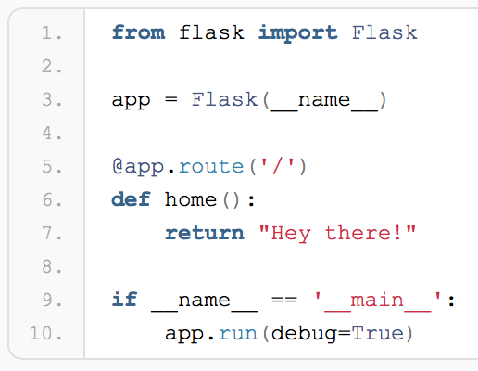
A bit more on Flask
How does Flask work?
User requests the domain’s root URL /
routes.py maps the URL / to a Python function
The Python function finds a template from /templates
A web template will look for other things such as CSS, JS and images in the /static folder
Rendered HTML is sent back to routes.py
routes.py sends HTML back to the browser
Typical structure for a basic Flask application
Source from above and good tutorial for getting started here: https://code.tutsplus.com/tutorials/an-introduction-to-pythons-flask-framework--net-28822
Hello world
Notes:
Line 1 = we are importing the libraries we need for out application. flask (lower-case f) is the framework here, while Flask (upper-case F) is a Python class.
In other words, the ptorotype that we will be used to create our web application instance.
Line 3 = Actually creates our instance - worth noting that __name__ is a special variable that gets the value __main__ when you are executing the script
Line 5-7 =
https://pythonhow.com/how-a-flask-app-works/

Slide 7
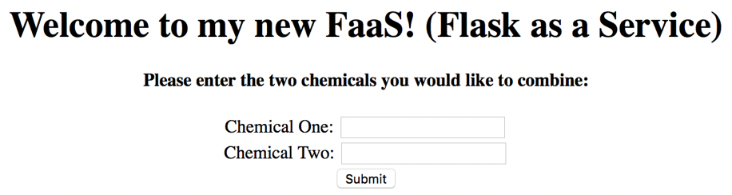
Flask…
So we are looking for the right INPUT and likely the application is running on FLASK.
So we need to look for some kind of input+vulnerability+flask on Google.
After some Googling, template injection comes up. I found a cheatsheet from a previous CTF write up that was useful https://pequalsnp-team.github.io/cheatsheet/flask-jinja2-ssti
We can test for this vulnerability by using something like {{7*7}}
Notes:
After a bit of exploring, there wasn’t much to find and only one clear piece of functionality.

Slide 8

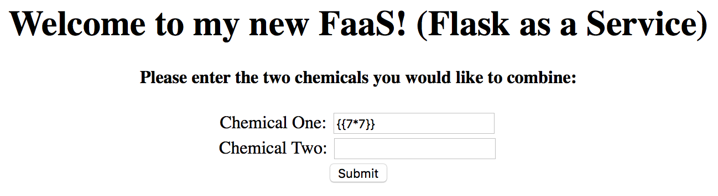

{{7*7}} = 49 and of course {{7*’7’}} = 7777777
Actually, 7x7 is maths, no? ;)

Slide 9
How does Template Injection work?
For it’s presentation layer, Flask uses the Jinga engine which allows you to create templates by using strings of HTML.
The template injection essentially allows an attacker to inject syntax into templates which is then executed in the context of the server.
This can lead to all sorts of fun stuff, like arbitrary RCE.
White paper from Blackhat:
https://www.blackhat.com/docs/us-15/materials/us-15-Kettle-Server-Side-Template-Injection-RCE-For-The-Modern-Web-App-wp.pdf
Notes:
Strings of HTML either in your python code or as includes (for scalability, obviously)
In the example later you will see it in-line but this is not really practical for commercial applications.
Also affects other template engines like twig and mako
Aside from exposing application variables and secrets, we can actually get command injection (restricted only by the permissions of the local application - but a lot of the time, this is root)

Slide 10
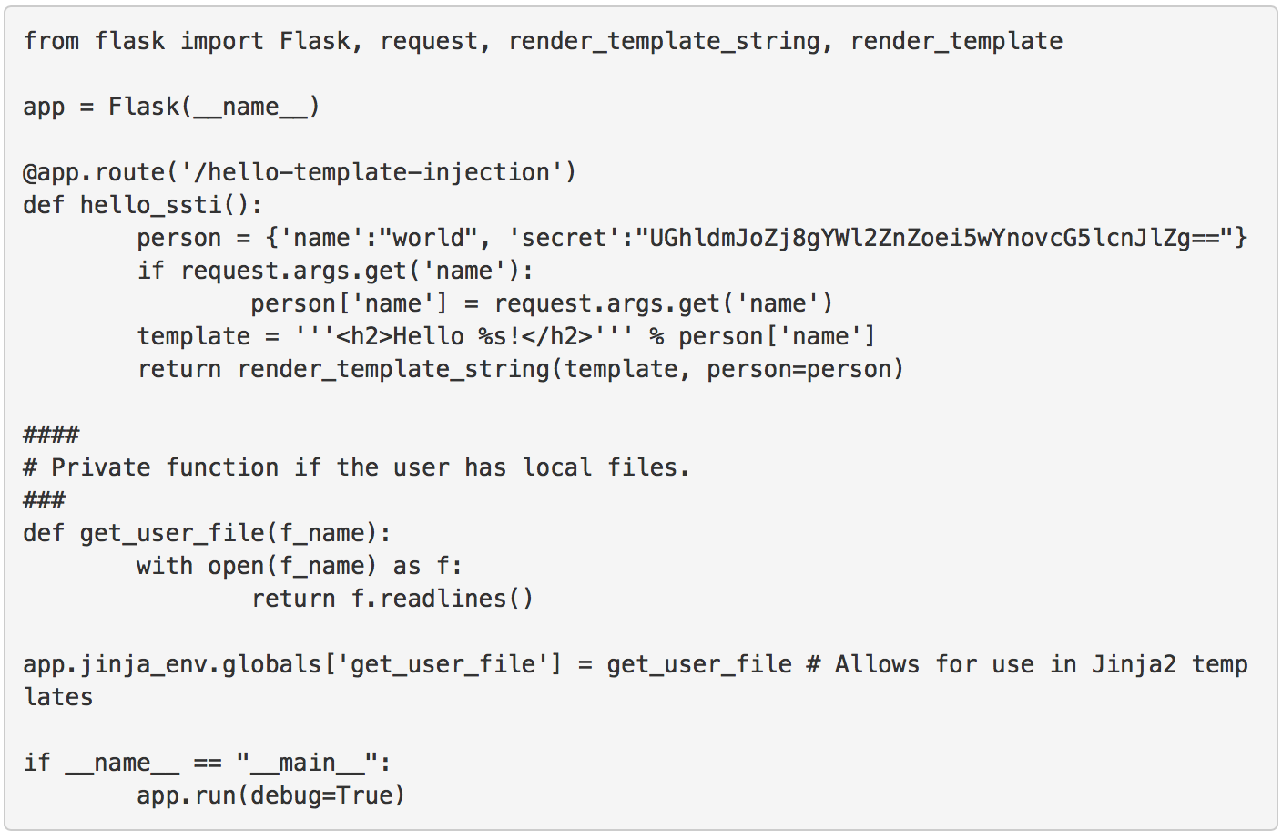
A quick example - stolen from the internet ;)
You can find the full article here
https://nvisium.com/blog/2015/12/07/injecting-flask.html

Slide 11
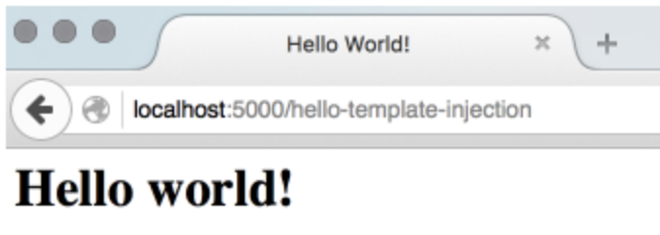

A quick example - stolen from the internet ;)

Slide 12
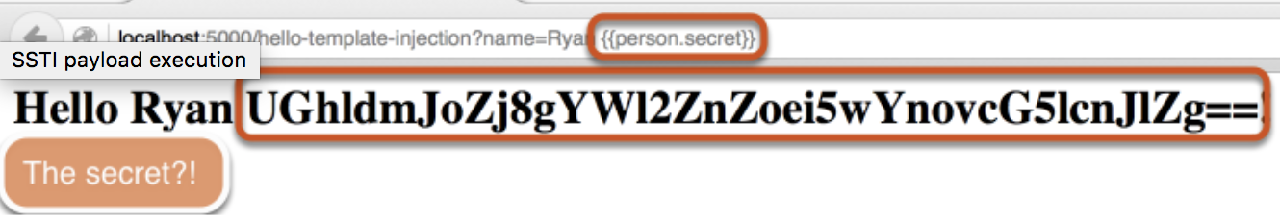
A quick example - stolen from the internet ;)
We can inject {{person.secret}} and get code execution on the server

Slide 13
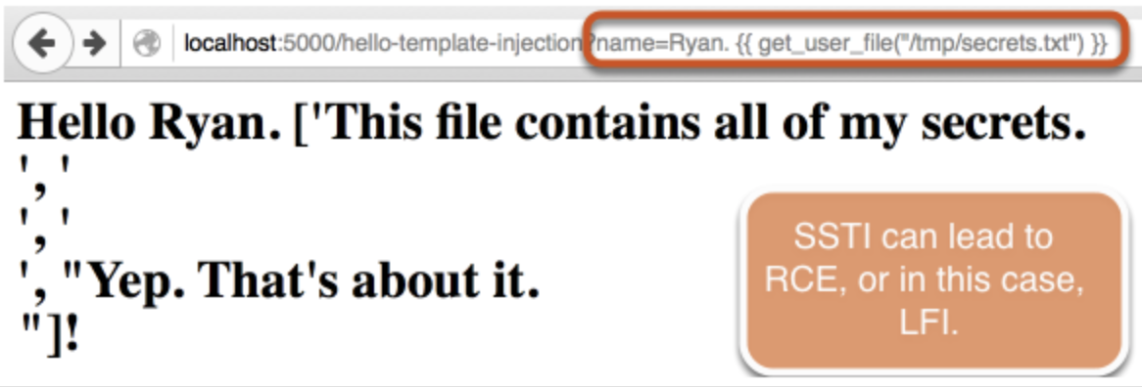
A quick example - stolen from the internet ;)
We can even get LFI!
In other vulnerable applications, the issue can range from simply displaying application variables to full RCE.

Slide 14
Finding flags
Introspection
With the locals object using dir and help to see everything that’s available in the template context.
{{request.application.__self__._get_data_for_json.__globals__['json'].JSONEncoder.default.__globals__['current_app'].config['FLAG’]}}
DoS
The request.environ object contains the method shutdown_server.
Extract classes
{{''.class.mro()[1].subclasses()}}
Arbitrary file read
{{ config.items()[4][1].__class__.__mro__[2].__subclasses__()[40](\"/tmp/flag\").read() }}
RCE
By using the subprocesses class we can issue arbitrary commands.
{{config.items()[4][1].__class__.__mro__[2].__subclasses__()[229]([\"touch /tmp/test\"], shell=True) }}
Samples from https://pequalsnp-team.github.io/cheatsheet/flask-jinja2-ssti

Slide 15
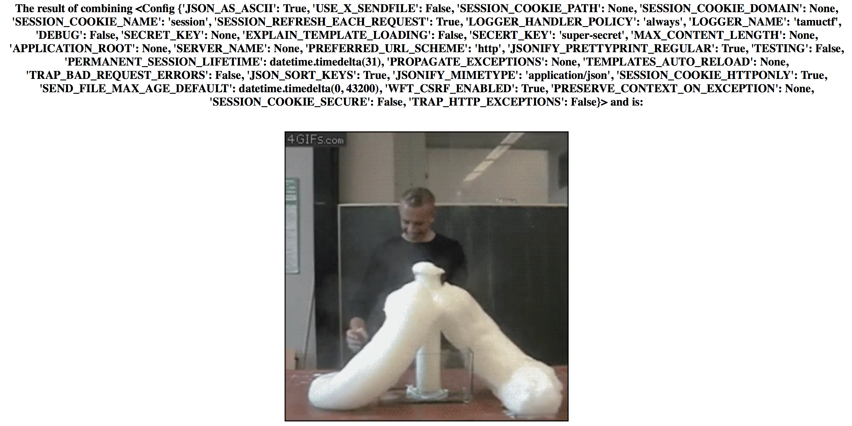
Finding the flag
There are quite a few paths to explore with this vulnerability.
Likely in CTF you are looking for RCE, LFI or information disclosure.

Slide 16
Finding the flag
Eventually, with a lot of trawling through the Flask documentation, and trial and error, I came to the solution by modifying the arbitrary file read found on https://pequalsnp-team.github.io
{{ config.items()[4][1].__class__.__mro__[2].__subclasses__()[40](\"/tmp/flag\").read() }}
{{ config.items()[4][1].__class__.__mro__[2].__subclasses__()[40]('flag.txt').read() }}
Slightly more elegant solution from another writeup:
{{''.__class__.__mro__[2].__subclasses__()[40]('flag.txt').read()}}

Slide 17


Slide 18
Reading about Server-Side Template Injection (SSTI)
https://www.blackhat.com/docs/us-15/materials/us-15-Kettle-Server-Side-Template-Injection-RCE-For-The-Modern-Web-App-wp.pdf
https://portswigger.net/blog/server-side-template-injection
Other templating engines (e.g. Twig and Mako) can can be vulnerable to the same attack, and the articles above also give information on how to enumerate which one you are attacking. So even if you are not attacking a Flask application, keep this vulnerability in mind.
Notes:
Won’t be surprised if we see similar tasks in upcoming CTFs that include filtering and maybe some flawed input sanitising to step up the difficulty a little.
Or more of an emphasis on first having to enumerate which templating engine is being used.

Slide 19
Other CTF tips (mostly for web)
Follow the news
Build some small web applications
Keep a repository of everything you’ve used or seen
Curl is really handy
Become a Burp Suite master
Learn HTTP
Do tonnes of CTFs and read the writeups
Put in reasonable effort but if after 2 hours you haven’t made any progress, you’ve probably missed something simple (or made a typo in your payload)

